Slide 1

School Leadership · Session 5
Working in Partnership
Notes:
SUGGESTED TIME: 1 min · 2:15 - 2:16
PURPOSE
Open the partnership session and connect it to the school-level design work.
WHAT TO DO
1. Name the shift from what the school can redesign to how home and school can understand and act together.
2. Explain that leaders shape the routines in which contact, meetings, decisions and follow-up happen.
3. Pick up the "I will share it with" line participants wrote on their Session 4 'My students' card, and the executive colleague they named on their Commit.
4. Keep the student at the centre of the conversation.
5. Acknowledge that participants may bring both productive and difficult partnership experiences, with families and within their own teams.
6. Remind the room that sharing is voluntary and examples stay anonymised (initials or roles only).
KEY MESSAGES
• Partnership is part of understanding and support, not an additional task after decisions are made.
• The student, family and school may each hold different parts of the picture.
• Leaders set up the conditions in which partnership conversations happen.
THREAD
Picks up the Session 4 'My students' card ("I will share it with") and the Commit table ("Who on my executive I will share it with"), Participant Guide p. 21.

Slide 2
Working in partnership
Family
School staff
What is the goal of these intersecting partnerships?
Every partner brings different knowledge and a different relationship with the student.
The student is at the centre of every partnership.
Student
Paraprofessionals
Notes:
SUGGESTED TIME: 3 min · 2:16 - 2:19 · Participant Guide p.22 - Session 5 summary
PURPOSE
Show where the partnerships around a student intersect, with the student at the centre of every one.
WHAT TO DO
1. Introduce the Venn: family, school staff and paraprofessionals, with the student at the centre.
2. Explain that every partner brings unique knowledge, expertise and perspectives, and a different relationship with the student and with each other.
3. Ask the group: What is the goal of these intersecting partnerships?
4. Steer the discussion so the point is made that the student is at the centre of all partnerships.
5. Link back where relevant: Autistic flourishing (Session 2), Autistic experience at school (Session 3), learning design and the continuum of support (Session 4).
6. Ask who is missing from the picture and how the student's communication can be included.
7. Ask leaders where their school's processes bring these partners together, and where their knowledge stays separate.
8. Point participants to Where partnerships converge in the Participant Guide (p. 22).
YOU MIGHT SAY
What is the goal of these intersecting partnerships?
KEY MESSAGES
• Positive partnership keeps the student at the centre.
• No single person holds the complete picture.
• Every partner brings different knowledge and a different relationship with the student.
KEEP IN MIND
• Use the elements as discussion prompts rather than a complete definition.
BACKGROUND
With session time limited, this slide is a chance to see where all the partnerships converge and what is needed for success across all of them.
THREAD
Draws on Autistic flourishing (Session 2), Autistic experience at school (Session 3) and the Session 4 school change and continuum of support.

Slide 3

Building a home-school partnership
Parents and families are the first and continuing educators of their children
Learning is lifelong and occurs in multiple settings
Partnerships, schools and school communities flourish when the diversity and strengths of families are valued and leveraged
Community engagement expands responsibility and resources
Partnerships grow from mutual trust, respect and responsibility
Partnerships need committed, collaborative and creative leadership
Family-School Partnerships Framework, Department of Education, 2020
Notes:
SUGGESTED TIME: 2 min · 2:19 - 2:21
PURPOSE
Make positive partnership concrete in school practice using the Family-School Partnerships Framework principles.
WHAT TO DO
1. Walk through the six Framework principles briefly.
2. Draw attention to the last principle: partnerships need committed, collaborative and creative leadership.
3. Position family knowledge and school knowledge as different, useful perspectives.
4. Name what makes partnership visible in practice: a shared purpose, respectful listening, student voice and communication, clear accessible information, and agreed next steps, responsibilities and follow-up.
KEY MESSAGES
• The student, family and school may each see different parts of experience. Partnership helps these perspectives inform understanding, design, action and review from the beginning.
• Listening, clarity and shared next steps can be observed in practice.
KEEP IN MIND
• Avoid implying that agreement is required before listening or respect are possible.
RESOURCES
Family-School Partnerships Framework - Department of Education, Australian Government - https://www.education.gov.au/supporting-family-school-community-partnerships-learning/family-school-partnerships/family-school-partnerships-framework

Slide 4
What is effective collaboration?
Shared goals
Seeing other perspectives
Shared values
Invite curiosity: How could we work together for better learning outcomes?
Mutual trust and respect
Centring student voice
Consult on decision-making
Assume good intent
Notes:
SUGGESTED TIME: 3 min · 2:21 - 2:24
PURPOSE
Name the collaboration principles that strong partnerships share, whoever is at the table.
WHAT TO DO
1. Introduce the importance of collaboration: for Autistic students there are multiple collaboration points across multiple partnerships.
2. Explain that the key collaboration skills are the same across all groups, and are vital for strong partnerships. They apply to leaders working with staff as well as with families.
3. Ask the group: What are some of the key principles for effective collaboration to occur?
4. Build the discussion to cover: shared goals, shared values, mutual trust and respect, consulting on decision-making, seeing other perspectives, inviting curiosity, centring student voice, assuming good intent.
5. If the cards are set to appear on click, reveal them once the room has contributed.
YOU MIGHT SAY
What are some of the key principles for effective collaboration to occur?
How could we work together for better learning outcomes?
KEY MESSAGES
• The collaboration skills needed are the same across every partnership around the student.
BACKGROUND
This slide was added by the team because it works well with all parties and helps shift perspectives.

Slide 5
Family engagement by design
Families should not depend on which teacher they happen to get.
First contact
Make the first contact each term a positive one.
Meeting protocols
Shaped with families, so meetings work for them.
Communication that lasts
Routines that keep going when staff change.
Access
Interpreters, different meeting formats and flexible times.
Ask families whether they feel heard, and act on what they tell you.
Notes:
SUGGESTED TIME: 4 min · 2:24 - 2:28 · Participant Guide p.22 - Session 5 summary (Family engagement by design)
PURPOSE
Show how a school can build the basics of family engagement into its routines, so the quality of partnership does not depend on which teacher a family has.
WHAT TO DO
1. Read the opening line: families should not depend on which teacher they happen to get.
2. Explain that in many schools, how well a family is included depends on individual staff. Leaders can set some basics that every family can expect.
3. Walk through the four cards.
4. First contact: make the first contact each term a positive one, so the first call or message home about a student is not about a problem.
5. Meeting protocols: shape them with families. For example, the agenda is sent ahead, a support person is welcome, there is time for questions, and a short written summary follows.
6. Communication that lasts: routines that keep going when staff change, such as agreed contact channels, a record of each family's communication preferences, and a handover when a teacher or case manager changes.
7. Access: interpreters, different meeting formats (in person, phone or online) and flexible times.
8. Ask: Which of these does your school already do reliably? Which ones depend on particular staff?
9. Point to the last line: ask families whether they feel heard, and act on what they tell you. This could be one question at the end of a meeting, a follow-up call, or an item in a family survey. Tell families what changed as a result.
YOU MIGHT SAY
Which of these does your school already do reliably? Which ones depend on particular staff?
KEY MESSAGES
• Family engagement can be part of a school's systems, as well as its individual relationships.
• First contact, meeting design, communication and follow-up are leadership concerns.
• Access (interpreters, formats and timing) is part of making partnership fair for every family.
• Asking families whether they feel heard is a practical way to check the system is working.
KEEP IN MIND
• Keep examples structural (norms, protocols, routines), rather than stories of one staff member doing it well or badly.
• Do not name or blame staff. Where something depends on one person, treat that as a gap in the process.
BACKGROUND
Family engagement can be designed at school level: first-contact norms, meeting protocols that families help shape, and communication routines that continue when staff change. Interpreter access, meeting formats and flexible timing affect which families can take part. Schools can also check how it is working by asking families whether they feel heard.
THREAD
A family-engagement routine can sit in the Session 4 School change sheet, under "This year: what we will build" or "The strategic plan: what makes it last".

Slide 6
Repairing trust
When a relationship with a family has broken down, leaders can often help reset it.
Earlier experiences
Many families carry difficult experiences with schools, not just with this teacher.
Acknowledge
Say what went wrong, without defending the process.
Listen first
Hear the family before offering solutions.
Agree a fresh start
A clear next step, who is responsible, and a follow-up date.
Repairing trust with families is part of a leader's role.
Notes:
SUGGESTED TIME: 3 min · 2:28 - 2:31 · Participant Guide p.22 - Session 5 summary (Repairing trust)
PURPOSE
Explore how leaders can help reset a relationship with a family when trust has broken down.
WHAT TO DO
1. Read the opening line: when a relationship with a family has broken down, leaders can often help reset it. A teacher cannot always do this alone.
2. Earlier experiences: explain that many families carry difficult experiences with schools over several years, not just with this teacher. Some arrive at a meeting expecting a difficult conversation before anything is said.
3. Acknowledge: say plainly what went wrong, without defending the process.
4. Listen first: hear the family's account before offering solutions.
5. Agree a fresh start: a clear next step, who is responsible, and a follow-up date. Then follow through.
6. Ask the group to think privately: What can a school acknowledge? What can it clarify? What can it change within its authority? What follow-through is possible?
7. Point to the last line: repairing trust with families is part of a leader's role.
YOU MIGHT SAY
What can a school acknowledge, clarify, change and follow through?
KEY MESSAGES
• Trust repair depends on listening, acknowledgement and reliable follow-through.
• Trust is mostly built in routine communication, so the basics on the previous slide help prevent breakdowns.
• Trust repair cannot promise a particular outcome. It can promise a clear next step and a follow-up.
KEEP IN MIND
• Do not ask participants to describe a current dispute or invite the group to solve an identifiable case.
• Some participants will have had hard encounters with families. Acknowledge that partnership works both ways, while keeping the focus on what the school can change.
• Follow local complaints and escalation processes; this slide does not replace them.
THREAD
Builds on Family engagement by design (slide 5) and leads into power dynamics (slides 7 - 8).

Slide 7

Power dynamics
Power can sit in:
Student
Socio-economic status
Historical / cultural experiences of education
Speaking English vs speaking a language other than English
Pedagogy / understanding of school systems and curriculum
Home
School
Perception of the importance / experience of school
Notes:
SUGGESTED TIME: 3 min · 2:31 - 2:34
PURPOSE
Help participants notice how agendas, language, authority and decision-making shape consultation.
WHAT TO DO
1. Introduce the seesaw: school, home and the student.
2. Name where power can sit: socio-economic status, historical and cultural experiences of education, speaking English or another language, understanding of school systems and curriculum, and perceptions of the importance of school.
3. Ask the power questions below to examine practice, not to blame individual participants.
4. Invite leaders to identify where school language, timing or process may create a barrier, and where the same barrier keeps coming up across families.
YOU MIGHT SAY
Who sets the agenda?
Whose knowledge is heard?
Who can make decisions?
Is the student included in a way that works for them?
What could the school change about the process?
Where could leadership change a barrier that keeps coming up?
KEY MESSAGES
• Power is present in meeting structures, language and decision pathways.
• Leaders can change a process when it repeatedly creates a barrier.
KEEP IN MIND
• Avoid describing a family as difficult, disengaged or unrealistic without examining the context and process.
THREAD
Follows Repairing trust (slide 6): families who arrive expecting a difficult meeting are often responding to how power has worked in earlier meetings.

Slide 8
Power dynamics activity
On Post-it notes:
1
Write an example of an imbalance in power dynamics from a home perspective.
2
Write an example of an imbalance in power dynamics from a school perspective.
3
Write how you could address these imbalances.
Share at your table, or add your notes to the wall under Home, School and Solutions.
6 minutes
Notes:
SUGGESTED TIME: 6 min · 2:34 - 2:40 · Participant Guide p.23 - Power dynamics
PURPOSE
Prompt educators to reflect on perceived and real power imbalances in the home-school relationship.
WHAT TO DO
1. Make sure every participant has Post-it notes and a pen.
2. Direct participants to the three instructions on the slide.
3. Choose a sharing option that suits the room (see steps).
4. Support tables to look for solutions rather than place blame, and to think about school processes as well as individual meetings.
5. Take feedback from a few participants at the end.
KEY MESSAGES
• Power can be structural, historical, cultural, conscious and unconscious.
• Status can be perceived as an imbalanced power dynamic, regardless of intent.
ACTIVITY: Post-it note reflection · table groups · 6 minutes
Prompt: Where do power imbalances sit in the home-school relationship, and how could you address them?
1. On one Post-it, write an example of an imbalance in power dynamics from a home perspective.
2. On a second, write an example from a school perspective.
3. On a third, write how you could address these imbalances.
4. Option 1: share Post-it notes with your table.
5. Option 2 (movement break): take your Post-it notes to another person in the room to share.
6. Option 3: place Post-it notes on butcher's paper on the wall under Home, School and Solutions.
Bring the room back:
• Who sets the agenda?
• Whose knowledge is heard?
• Who can make decisions?
• What could the school change about the process?
• Which of these solutions would need a leadership decision?
Close: Ask participants to keep one process change for their conversation plan.
KEEP IN MIND
• This may be challenging for some participants, who may have found themselves in positions of power or lack of power at different times in their career. Guide individuals to seek solutions and not place blame.
BACKGROUND
Educators are immersed in the culture of education, including a shared understanding of acronyms (e.g. NAPLAN, NCCD, IEP) which families may not be able to access as easily. Some people will purposely and naturally endow teachers with higher status, which can be a cultural or personal attitude. External providers and professionals can also affect the power dynamic between those working with and supporting Autistic students.
THREAD
The process change chosen here carries into the bridge reflection (slide 19) and the Session 6 conversation plan.

Slide 9

Student voice
What decisions were made, and who made them?
What impact did those decisions have on Adon?
Notes:
SUGGESTED TIME: 5 min · 2:40 - 2:45 · Participant Guide p.23 - Student voice
PURPOSE
Show what happens when a student is not listened to or consulted.
WHAT TO DO
1. Introduce the video as an example of a student who is not listened to or consulted.
2. Ask participants, while watching, to pay attention to what decisions were made and who made them.
3. Play the video.
4. Ask the group: What impact did those decisions have on Adon?
5. Connect to the students participants have in mind: how are their preferences asked and heard, and where does the school record them?
YOU MIGHT SAY
While watching, pay attention to what decisions were made and who made them.
What impact did those decisions have on Adon?
KEY MESSAGES
• Students should have a say in decisions about them, at their level and in the way they communicate.
• Even young children can show preferences: choices offered visually, reactions observed and honoured.
• Ask students in a way that works for them: what helps? what's hard? what should teachers know?
• Record their answers in their own words, so the student's view is part of the record.
• This is an early step in building self-advocacy.

Slide 10
Partnership activity
For each partner: what do they bring, and what challenges might they face?
Student
Parents and carers
Teachers
Paraprofessionals
Brings
Brings
Brings
Brings
Challenges
Challenges
Challenges
Challenges
8 minutes
Then compare: what do all four have in common?
Notes:
SUGGESTED TIME: 8 min · 2:45 - 2:53 · Participant Guide p.24 - Partnership activity
PURPOSE
Compare what each partner brings and the challenges they may face, and find what they share.
WHAT TO DO
1. Make sure each table has the Partnership activity grid in the Participant Guide (p. 24).
2. Ask table groups to record what each partner brings and what challenges they might face: student, parents and carers, teachers, paraprofessionals.
3. Ask tables to compare: what do all four have in common?
4. Take thoughts on similarities and differences, list the commonalities, and ask what would make the partnership more successful.
KEY MESSAGES
• Understanding the challenges and strengths of each partner can help build trust and confidence in the relationship.
• There are similarities and differences between what each partner brings to the partnership.
• Everyone has the student at the centre and student voice is included.
• At the heart of all interactions there should be an assumption of good intent regarding the outcomes for the student.
ACTIVITY: Table group partnership grid · table groups · 8 minutes
Prompt: For each partner: what do they bring, and what challenges might they face?
1. Work through the four partners: student, parents and carers, teachers, paraprofessionals.
2. For each, note what they bring and what challenges they might face.
3. Compare: what do all four have in common?
Bring the room back:
• What are the similarities and differences across the four partners?
• What would make the partnership more successful?
Close: List the commonalities the room names and link them to the collaboration principles on slide 4.

Slide 11

What works?
Think of a family you have a good relationship with.
How did you establish this? What does it look like? Why does it work?
What works for everyone at the table:
Be prepared for meetings
Share information
Ask questions
Seek clarification
Assume the best
6 minutes
Notes:
SUGGESTED TIME: 6 min · 2:53 - 2:59 · Participant Guide p.24 - What works?
PURPOSE
Draw on relationships with families that already work, and name the moves that work for everyone at the table.
WHAT TO DO
1. Ask participants, in their school groups, to think of a family they have or have had a good relationship with.
2. Discuss the prompts on the slide.
3. Ask groups to feed back some of the key ideas to the whole room.
4. Point to the list of what works for everyone at the table, and add the educator side of each move.
YOU MIGHT SAY
How did you establish this? What does it look like? Why does it work?
KEY MESSAGES
• Send the agenda before the meeting, so families know what to expect.
• Welcome a support person. This is normal and allowed, and it can change the dynamic of the meeting.
• Open with a strength; share notes or minutes.
• Follow up in writing ('as we agreed...'), so everyone is clear on what was agreed.
• If it went wrong: acknowledge it, offer a reset, and make the next meeting fairer.
ACTIVITY: School group reflection · small groups · 6 minutes
Prompt: Think of a family you have a good relationship with. How did you establish this? What does it look like? Why does it work?
1. Think of a family you have or have had a good relationship with.
2. Discuss the three prompts in your school group.
3. Keep examples anonymised.
Bring the room back:
• What key ideas came up in your group?
Close: Connect the ideas shared to the list of what works for everyone at the table.
BACKGROUND
Parent and family engagement in learning happens when schools and educators support families, understanding and leveraging how they interact with their child's learning, and supporting them to do that in equal partnership with the school. Parents and families need to know how important their continued support for learning is, and that as the experts in their child they are an extremely valuable resource. Educators have a vital role to play here (Barker & Harris, 2020).
RESOURCES
Barker, B., & Harris, D. (2020). Parent and Family Engagement: An Implementation Guide for School Communities. Canberra: ARACY
Tett, L. & Macleod, G. (2020) Enacting home-school partnerships: the roles of headteachers, family-learning practitioners and parents, Cambridge Journal of Education, 50:4, 451-468 https://doi.org/10.1080/0305764X.2020.1722062

Slide 12
Meeting families where they are
Listen before solving.
Ask about communication preferences and priorities
Make room for questions and uncertainty
Explain roles, options and next steps plainly
Check what is workable for the family now
Avoid judging a family's pace, response or choices
Environment-first thinking applies to meetings too: what could the school change about the process?
Notes:
SUGGESTED TIME: 2 min · 2:59 - 3:01
PURPOSE
Emphasise listening before solving, and making room for questions, uncertainty and different priorities.
WHAT TO DO
1. Read the six practices briefly.
2. Emphasise listening before solving and making room for questions, uncertainty and different priorities.
3. Invite leaders to identify where school language, timing or process may create a barrier.
4. Make the key point: environment-first thinking applies to meetings too. Where the same barrier comes up for many families, it is a process the school can change.
YOU MIGHT SAY
What could the school change about the process?
KEY MESSAGES
• Power is present in meeting structures, language and decision pathways.
• Meeting families where they are begins with listening and clarity.
• Environment-first thinking also applies to consultation processes.
KEEP IN MIND
• Avoid judging a family's pace, response or choices.
• Avoid describing a family as difficult, disengaged or unrealistic without examining the context and process.

Slide 13
Consultation literacy
Useful consultation includes:
A clear, shared purpose
Open questions
More than one way to contribute
Respect for student and family knowledge
Accurate recording of what was heard
An agreed action, responsibility and follow-up
Ask, listen, and follow up.
Notes:
SUGGESTED TIME: 3 min · 3:01 - 3:04 · Participant Guide p.25 - Consultation checklist
PURPOSE
Introduce consultation literacy: asking, listening and following up, with families and students and with the school's own staff.
WHAT TO DO
1. Walk through what useful consultation includes.
2. Frame the list as a check participants can use before and after a meeting.
3. Make the point: ask, listen, and follow up.
4. Turn the list towards the school's own staff: leaders can consult their staff in the same way they ask staff to consult families.
5. Explain that support staff often have the closest hour-by-hour picture of a student's day. Ask: How does what they notice reach decisions in your school?
6. Ask: Have teachers been asked where the timetable and routines are hardest for students?
7. Offer three questions from the team's leadership materials that a leadership team can put to staff: What evidence do we expect? What enables consistent adjustments? What is our unique responsibility?
8. Follow up with staff as you would with families: tell them what was heard and what changed.
YOU MIGHT SAY
How does what support staff notice reach decisions in your school?
KEY MESSAGES
• Ask, listen, and follow up.
• Tools should support consultation rather than replace listening and student voice.
• Leaders can consult staff the same way they ask staff to consult families.
• Staff who are consulted well are better placed to consult families and students well.
KEEP IN MIND
• Keep the staff discussion about processes and roles. Do not name or blame staff.
BACKGROUND
Support staff often hold the closest hour-by-hour picture of a student's day in the school, and teachers know where the timetable and routines are hardest. Consulting them uses the same checklist as consulting families: a clear purpose, open questions, more than one way to contribute, accurate recording and an agreed action with follow-up. How leaders consult staff shapes how staff consult families and students.

Slide 14
Consulting students and families
With students
With families
Offer communication choices
Meeting preparation
Start with students’ strengths and interests
Listen to families and value their insights
Simple choices
Processing time
Use clear, simple language
Respect different perspectives / experiences
Sensory-friendly spaces
Behaviour as communication
Focus on needs, goals and participation
Use real examples from school
Strengths and interests
Support - don’t speak for
Check for shared understanding
Agree on next steps
Clear, accessible questions
Keep communication open and ongoing
Notes:
SUGGESTED TIME: 2 min · 3:04 - 3:06
PURPOSE
Give practical ways to consult students and families so every voice can be heard.
WHAT TO DO
1. Take the two columns in turn: with students, then with families.
2. With students: presume competence, provide communication supports, offer choices, allow time, and act on what students tell us.
3. With families: start with the student's strengths, interests and what works well, and listen to families' knowledge of their child without making assumptions.
4. Ask participants to pick one practice from each column that the school could build into its usual meeting processes.
KEY MESSAGES
• Listen, adapt, give choices, and make it easy for every student to have a voice.
• Ensure trusted supporters assist communication without replacing the student's voice.
• Use plain language and explain educational terms clearly.
• Focus on the student's needs and goals, not just their diagnosis.
• Recognise that some parents will be neurodivergent themselves.
BACKGROUND
Student consultation: provide multiple communication options (AAC, visuals, writing, drawing, video, symbols); prepare students in advance with questions, agendas and meeting information; use supported decision-making with simple choices and extra processing time; create sensory-friendly environments; recognise that behaviour is communication and can indicate preferences; build on strengths, interests and preferences; use accessible, strengths-based questions. Family consultation: be respectful of different cultures, experiences and family perspectives; use real examples from school to discuss supports and adjustments; check everyone has the same understanding; agree clear next steps and how progress will be reviewed; keep communication open and ongoing.
THREAD
Picks up the continuum of support and NCCD from Session 4.

Slide 15
When student capacity runs out
Discuss capacity without blame. Home and school may observe different parts of the student's experience.
Meltdown
Shutdown
School Can’t
Focus on safety, what preceded the situation, what supports recovery and what can change in the environment, task or response.
Notes:
SUGGESTED TIME: 2 min · 3:06 - 3:08
PURPOSE
Introduce meltdown, shutdown and School Can't within partnership discussion, without blame.
WHAT TO DO
1. Introduce the three terms without presenting them as wilful behaviour.
2. Connect discussion to accumulated demands, what may not be visible, and what home and school can learn from each other.
3. Ask what information, listening and environmental change would help the team respond more safely and usefully.
4. Ask leaders whether relevant staff know the school's local wellbeing, safety and support pathways.
5. Point to the focus line: safety, what preceded the situation, what supports recovery and what can change in the environment, task or response.
KEY MESSAGES
• Capacity should be discussed without blame.
• Home and school may observe different parts of the student's experience.
• Use non-blaming language and the workshop safety guidance.
• Leaders are responsible for making local response pathways clear to staff.
KEEP IN MIND
• Do not frame meltdown, shutdown or School Can't as wilful misbehaviour or a failure of parenting.
• Do not offer clinical, diagnostic, legal or crisis guidance beyond the material.
THREAD
Builds on capacity and accumulated demands from Sessions 2 and 3.

Slide 16
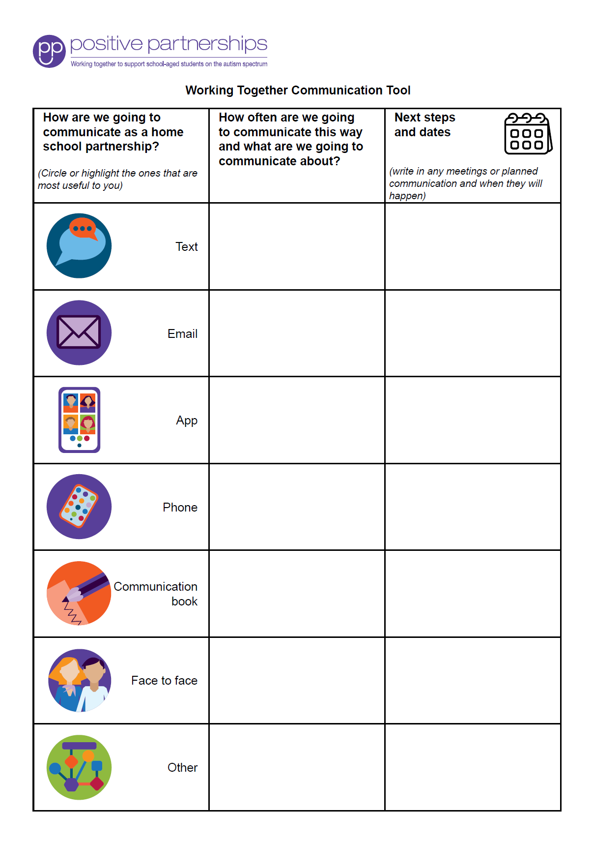
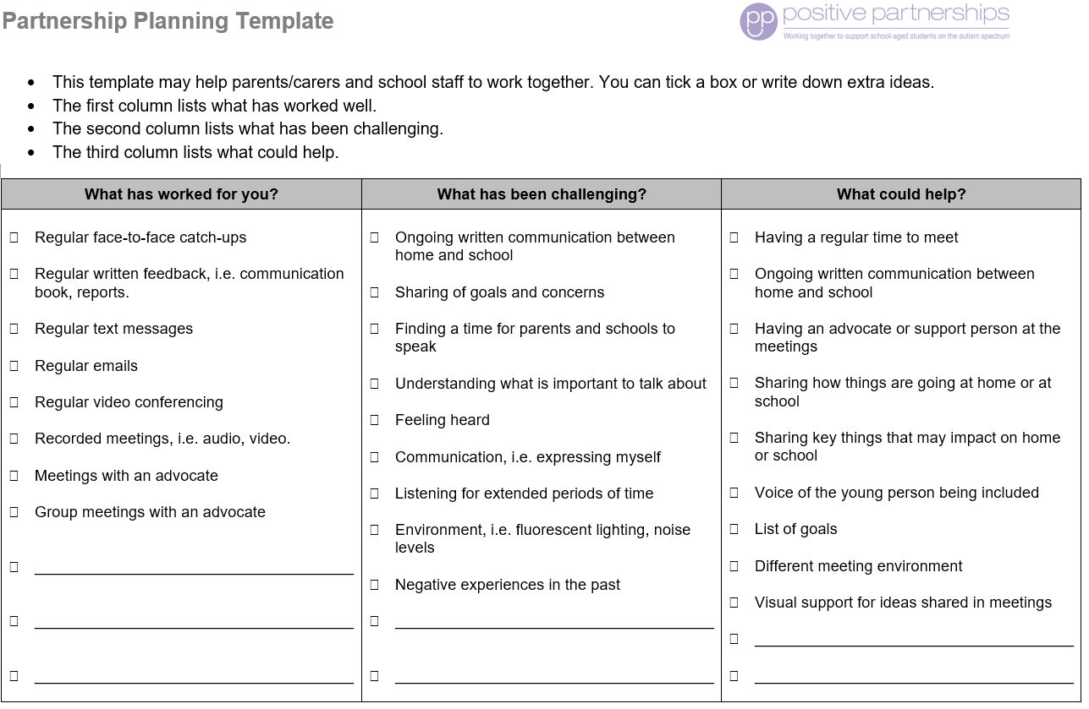
Partnership tools
Notes:
SUGGESTED TIME: 1 min · 3:08 - 3:09
PURPOSE
Demonstrate the Partnership tools and explain how they are used.
WHAT TO DO
1. Show the Partnership tools and explain how each is used.
2. Frame the tools as supports for consultation, not replacements for listening.
3. Ask how each tool would fit the school's existing meeting, decision and review processes.
KEY MESSAGES
• Tools should support consultation rather than replace listening and student voice.

Slide 17
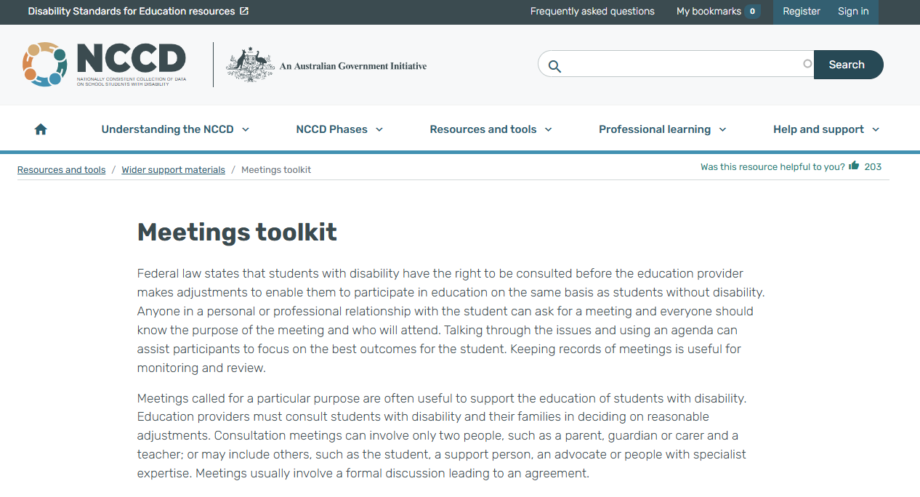
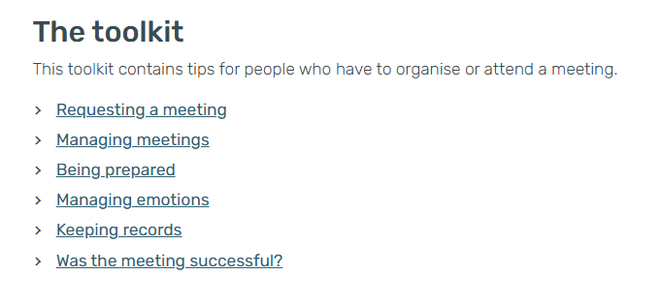
NCCD Meetings Tool Kit
Use the toolkit to make the meeting purpose, consultation process, possible adjustments, evidence and next steps clear. Follow the processes used in your school or system, and explain responsibilities and follow-up.
Notes:
SUGGESTED TIME: 1 min · 3:09 - 3:10
PURPOSE
Introduce the NCCD Meetings Tool Kit and direct participants to official NCCD information.
WHAT TO DO
1. Explain how the Tool Kit makes the meeting purpose, consultation process, possible adjustments, evidence and next steps clear.
2. Remind participants to follow the processes used in their school or system.
3. Ask leaders to check who in their school uses the Tool Kit, who makes decisions, how student and family knowledge is included, and what is recorded.
4. Emphasise explaining responsibilities and follow-up to families.
5. Direct participants to official NCCD information.
KEY MESSAGES
• NCCD information must be current and official.

Slide 18
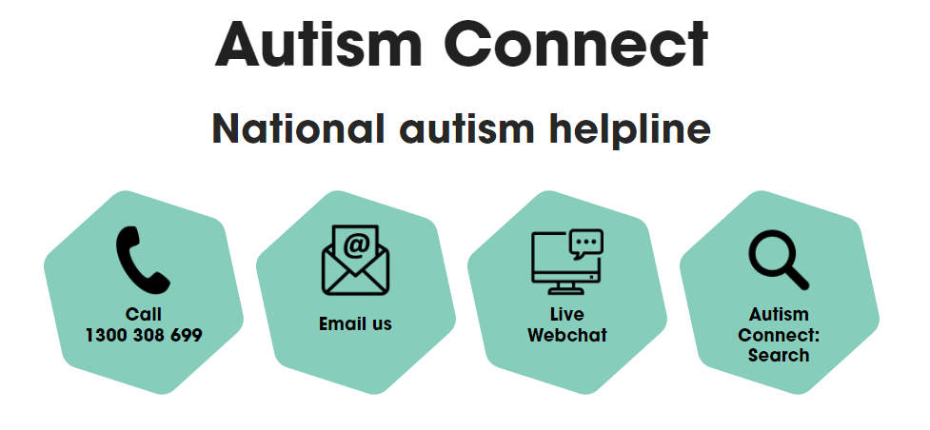


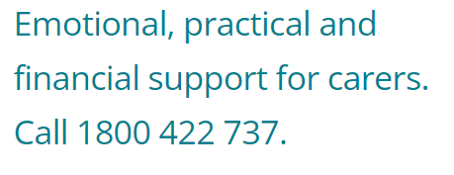

Other practical supports
Notes:
SUGGESTED TIME: 1 min · 3:10 - 3:11
PURPOSE
Introduce the support pathways included in the workshop.
WHAT TO DO
1. Briefly introduce the Positive Partnerships support options and other supports on the slide.
2. Point participants to Participant Guide p. 30 for resources.
KEY MESSAGES
• Introduce the Positive Partnerships support options included with the workshop.
KEEP IN MIND
• Check phone numbers and services are current before delivery.

Slide 19
Bridge to the next family conversation
Prepare for one purposeful conversation.
What needs to be understood?
What question will open the conversation?
How will the student's voice be included?
What can be decided together?
How and when will the school follow up?
Keep these notes for your conversation plan in Session 6.
Notes:
SUGGESTED TIME: 4 min · 3:11 - 3:15 · Participant Guide p.25 - Bridge to the next family conversation
PURPOSE
Identify the question and shared purpose participants will take into the Session 6 conversation plan.
WHAT TO DO
1. Ask participants to return to the students they have in mind and their Session 4 school change.
2. Invite them to work through the prompts on the slide privately.
3. Keep the focus on preparation rather than scripting what the family should say.
4. Ask participants to carry one process change from the power reflection into the plan.
5. Preview the closing session on belonging, capacity, joy and practical next steps.
YOU MIGHT SAY
Keep these notes for your conversation plan in Session 6.
KEY MESSAGES
• Prepare for one purposeful conversation.
ACTIVITY: Private bridge reflection · on your own · 4 minutes
Prompt: Prepare for one purposeful conversation.
1. What needs to be understood?
2. What question will open the conversation?
3. How will the student's voice be included?
4. What can be decided together?
5. How and when will the school follow up?
Close: Keep these notes available for the family-conversation plan in Session 6.
THREAD
Connects to the Session 4 'My students' card ("I will share it with") and the conversation plan in Session 6 (Participant Guide p. 28).

